Slide 1
DevOps
Lesson 06 : DevOps IBM Bluemix
Notes:
Add instructor notes here.

Slide 2
Lesson Objectives
Introduction to IBM Bluemix
Working with Bluemix –CLI & Eclipse
Bluemix with DevOps
Other Tools of DevOps
Notes:
Add instructor notes here.

Slide 3
6.1:Introduction to IBM Bluemix IBM Bluemix
IBM Bluemix is IBM's innovative cloud computing platform that combines platform as a service (PaaS) with infrastructure as a service (IaaS).
Fits for small business that plans to scale, or a large enterprise that requires additional isolation
IBM Cloud Data Centers provide regional redundancy, a global network backbone connecting all data centers and points of presence, and stringent security controls and reporting.
IBM Bluemix Dashboard are:
Apps
Services
Infrastructure
Notes:
Apps
The Apps dashboard provides everything you need to get your apps up and running, and to manage those apps while they run. Bluemix provides various boilerplates and runtimes:
A boilerplate is a template for an application and its associated runtime environment and predefined services for a specific domain.
A runtime is the set of resources that is used to run an app, provided as containers for different types of apps.
Bluemix provides various ways for you to run your apps, for example, Cloud Foundry and IBM® Bluemix Container Service. Use IBM Bluemix Container Service to run Docker containers in a hosted cloud environment on Bluemix.
You can use IBM® Bluemix® OpenWhisk for distributed, event-driven computing. OpenWhisk runs application logic in response to events or direct invocations from web or mobile apps over HTTP.
You can use Bluemix Mobile services to incorporate pre-built, managed, and scalable cloud services into your mobile apps.
Services
The Services dashboard provides access to the Bluemix services available from IBM® and third-party providers. These include Watson, Internet of Things, Analytics, Mobile, and DevOps services:
Deliver innovative new applications faster and cheaper with just the right features using IBM DevOps services and the Bluemix Garage Method. When you adopt DevOps practices and create a culture of innovation and agility, you can use iterative practices and change direction in response to the market.
Blockchain is a peer-to-peer distributed ledger technology for a new generation of transactional applications that establishes trust, accountability, and transparency while streamlining business processes.
Watson gives your apps the power of cognitive computing with a full suite of speech, vision, and data APIs. Solve your most complex business problems by deploying a cognitive platform with Watson services.
IBM enables you to do more with rich, integrated cloud databases and Data & Analytics services.
The IBM Internet of Things service lets your apps communicate with, and consume data that is collected by, your connected devices, sensors, and gateways. Our recipes make it easy to get devices connected to our Internet of Things cloud. Your apps can then use our real-time and REST APIs to communicate with your devices and consume the data you've set them up to collect.
IBM offers a mobile backend infrastructure where you can build multiplatform, native, or hybrid apps while also being able to monitor and test them. You can also enhance your app with analytics, security, user insight, and continuous delivery.
Bluemix also provides experimental services that you can try out. To learn about service types and availability, see Bluemix services
Infrastructure
Add instructor notes here.

Slide 4
6.1:Introduction to IBM Bluemix IBM Bluemix
Notes:
The Infrastructure dashboard provides various services to fit your cloud infrastructure needs.
Bluemix infrastructure provides the highest performing cloud infrastructure available. Bluemix infrastructure is one platform, which takes data centers around the world that are full of the widest range of cloud computing options, then integrates and automates everything. IBM Cloud Data Centers are filled with first class computing, storage, and networking gear. Each location is built, outfitted, and operated in the same way, so you get exactly the same capabilities and availability anywhere where we are present. Locations are connected by the industry’s most advanced network-in-a-network, which integrates distinct public, private, and internal management networks to deliver lower total networking costs, better access, and higher speed. Also, the data centers and network share a single proprietary management system. One management tool lets you control everything--every bare metal server, virtual server, and storage device--all accessible by API, portal, and mobile applications.
Bluemix infrastructure offers powerful bare metal servers and flexible virtual servers in a single seamless platform. All are provided on demand and billed on monthly or hourly terms. Bare metal servers provide the raw horsepower for your processor-intensive and disk I/O-intensive workloads and can be configured to your exact specifications. Virtual servers allow for high speed of deployment, flexible scalability, and pay-as-you-go billing. For high performance computing, give your cloud a boost with graphics processing unit (GPU) servers, available by the hour or monthly.
Bluemix infrastructure offerings are connected to a three-tiered network, segmenting public, private, and management traffic. Infrastructure on a customer's Bluemix account might transfer data between such infrastructure across the private network at no cost. Infrastructure offerings, such as bare metal servers, virtual servers, and cloud storage, connect to other applications and services in the Bluemix catalog, such as Watson services, containers, or runtimes, across the public network. Data transfer between those two types of offerings is metered and charged at standard public network bandwidth rates.
Using the B
Add instructor notes here.

Slide 5
6.1:Introduction to IBM Bluemix IBM Bluemix
IBM enables you to:
Deploy high performance compute and storage infrastructure in secure IBM Cloud Data Centers around the world.
Test and adopt a broad range of cloud services and capabilities from IBM, open source communities, and third-party developers.
Connect to all legacy systems and apps from a single, scalable, cloud platform through private network and API capabilities.
Spin up and turn down resources in real time as your business needs or workload demands change.
Notes:
Add instructor notes here.

Slide 6
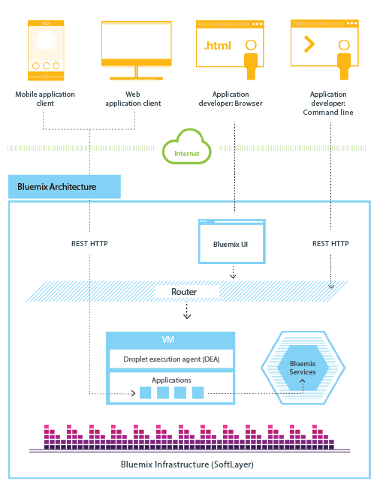
6.1:Introduction to IBM Bluemix IBM Bluemix
Bluemix Cloud Foundry Architecture
Clients--which can be mobile apps, apps that run externally, apps that are built on Bluemix, or developers that are using browsers--interact with the Bluemix-hosted apps.
Clients use REST or HTTP APIs to route requests through Bluemix to one of the app instances or the composite services.
Notes:
How Bluemix cloud Foundry works
the operating system and infrastructure layers when running apps on Bluemix in Cloud Foundry. Layers such as root filesystems and middleware components are abstracted so that you can focus on your application code. However, you can learn more about these layers if you need specifics on where our app is running.
When we deploy an app to Bluemix Cloud Foundry, we must configure Bluemix with enough information to support the app.
For a mobile app, Bluemix contains an artifact that represents the mobile app's back end, such as the services that the mobile app uses to communicate with a server.
For a web app, we must ensure that information about the runtime and framework is communicated to Bluemix, so that Bluemix can set up the appropriate execution environment to run the app.
Each execution environment, including both mobile and web, is isolated from the execution environment of other apps. The execution environments are isolated even though these apps are on the same physical machine. The following figure shows the basic flow of how Bluemix Cloud Foundry manages the deployment of apps:
Add instructor notes here.

Slide 7
6.1:Introduction to IBM Bluemix IBM Bluemix
Notes:
When you create an app and deploy it to Bluemix Cloud Foundry, the Bluemix environment determines an appropriate virtual server to send the app, or the artifacts that the app represents, to. For a mobile app, a mobile back-end projection is created on Bluemix. Any code for the mobile app running in the cloud eventually runs in the Bluemix environment. For a web app, the code running in the cloud is the app itself that the developer deploys to Bluemix. The determination of the virtual server is based on several factors, including:
The load already on the machine Runtimes or frameworks supported by that virtual server. After a virtual server is chosen, an application manager on each virtual server installs the appropriate framework and runtime for the app. Then, the app can be deployed into that framework. When the deployment completes, the application artifacts are started.
The following figure shows the structure of a virtual server, also known as Droplet execution agent (DEA), that has multiple apps deployed to it:
Add instructor notes here.

Slide 8
6.1:Introduction to IBM Bluemix IBM Bluemix
Prerequisite of Bluemix
Any latest version browser (chrome,safari,IE) for our operating system
Cloud Foundry command line interface, Version 6.5.1 or later
Install with eclipse
Open Help > Eclipse Marketplace. Search for Bluemix.
Select the IBM Eclipse Tools for Bluemix entry and click Install.
By default, there are features selected for you. Click Confirm.
Accept the license agreement and click Finish.

Slide 9
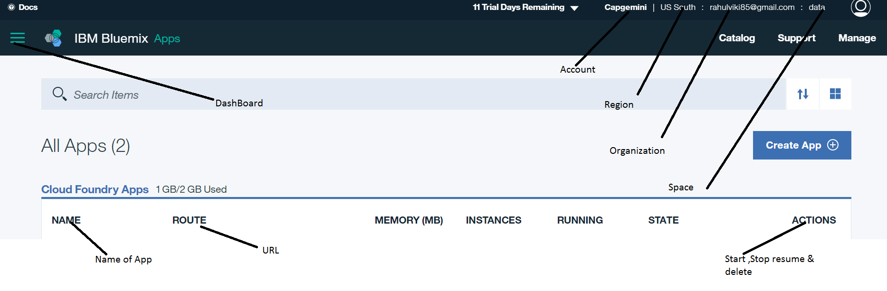
6.1:Introduction to IBM Bluemix IBM Bluemix
Creating Account in BlueMix
Go https://console.ng.bluemix.net/ & create bluemix account
Give your Space, Region

Slide 10
6.1:Introduction to IBM Bluemix IBM Bluemix
Region & Spaces
A Bluemix region is a defined geographical territory that we can deploy our apps to. We can create apps and service instances in different regions with the same
Bluemix infrastructure for application management and the same usage details view for billing.
We can select the region that is nearest to your customers and deploy your apps to this region to get low application latency.
Different region to work with the spaces in that region
Following command to link with European united kingdom region
cf api https://api.eu-gb.Bluemix.net
Following command to link with US South region
cf api https:// api.ng.bluemix.net
Following command to link with Sydney region
cf api https://api.au-syd.bluemix.net

Slide 11
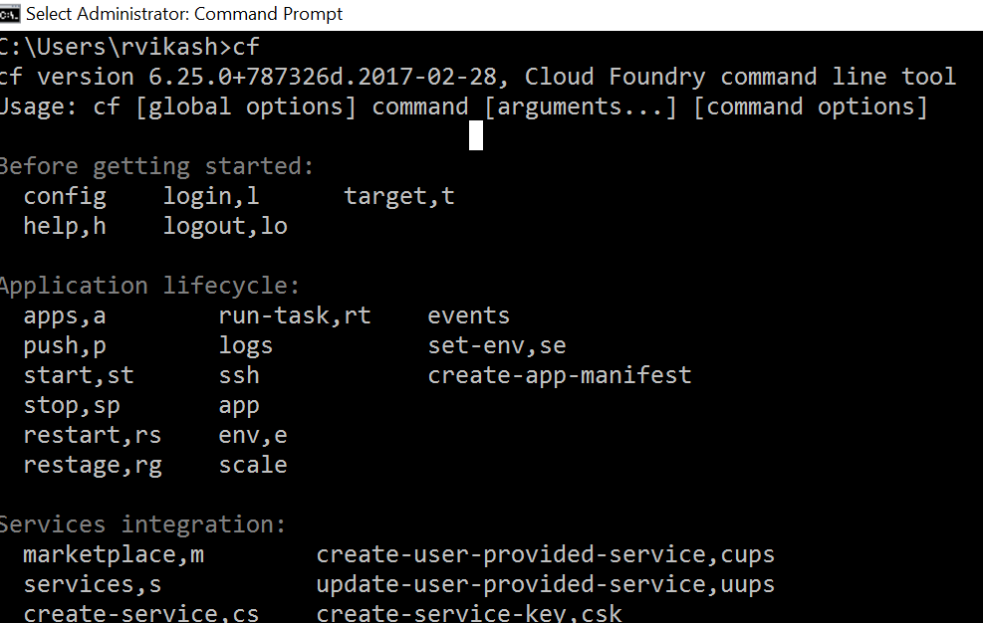
6.2:Working with Bluemix IBM Bluemix
Working with CLI
Install CLI
Open Command prompt ,write cf
Connect and log in to Bluemix.
cf api https://api.ng.bluemix.net

Slide 12
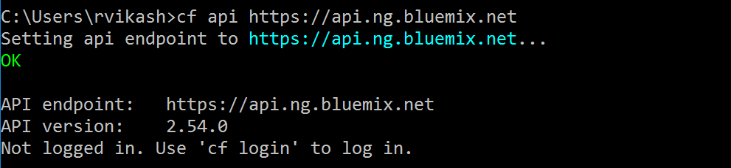
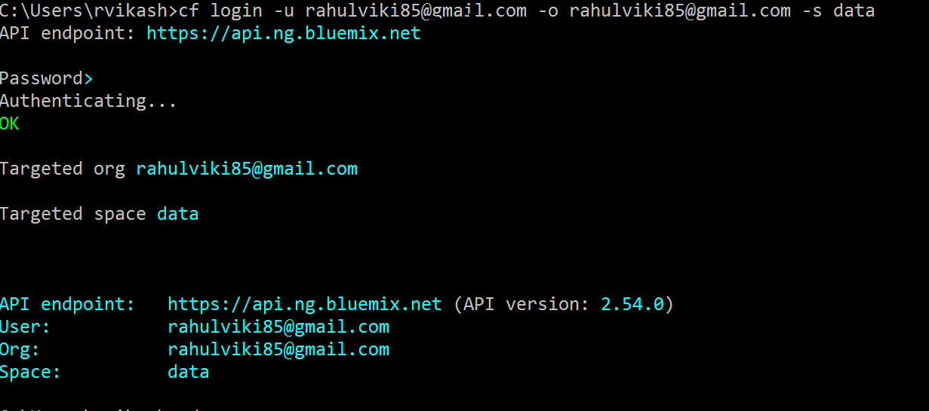
6.2:Working with Bluemix IBM Bluemix
Make login by giving username,org_name,space_name
cf login -u username -o org_name -s space_name

Slide 13
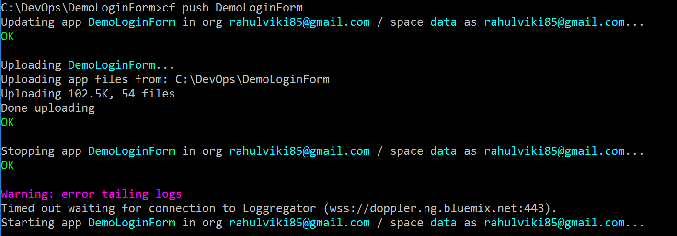
6.2:Working with Bluemix IBM Bluemix
Deploy our bluemix app using cf push command
cf push app_name -→ cf push DemoLoginForm

Slide 14
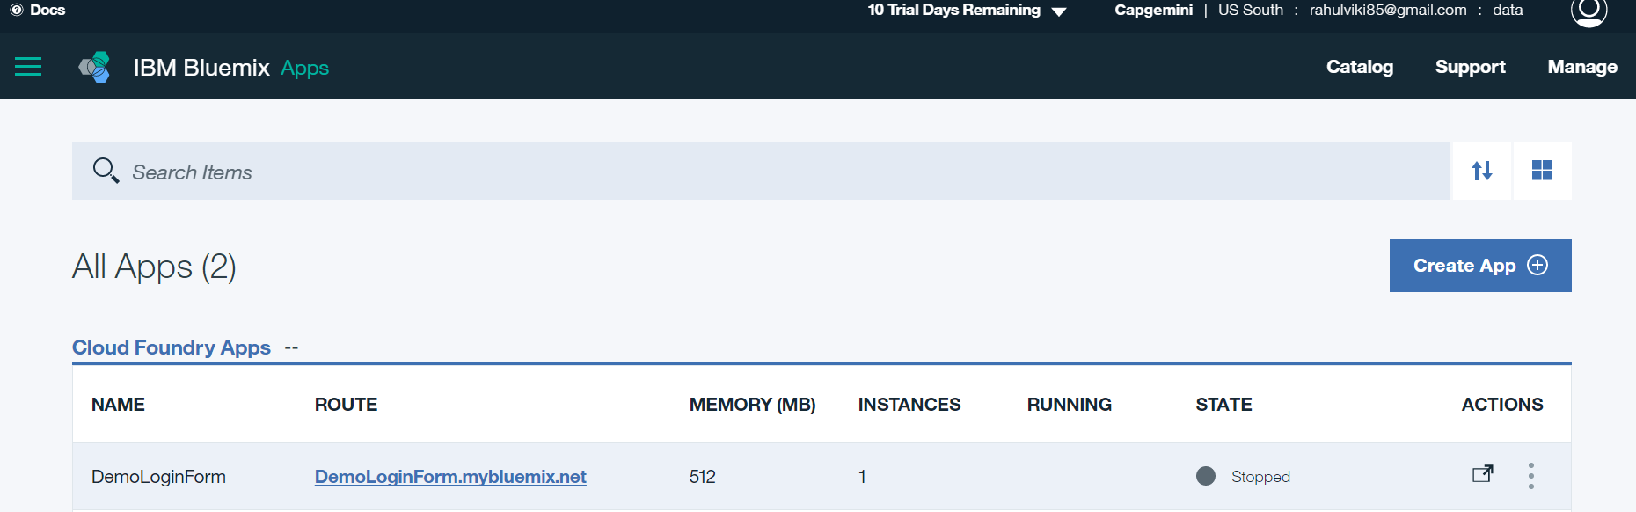
6.2:Working with Bluemix IBM Bluemix
DemoLoginForm uploaded on https://console.ng.bluemix.net/dashboard/apps

Slide 15
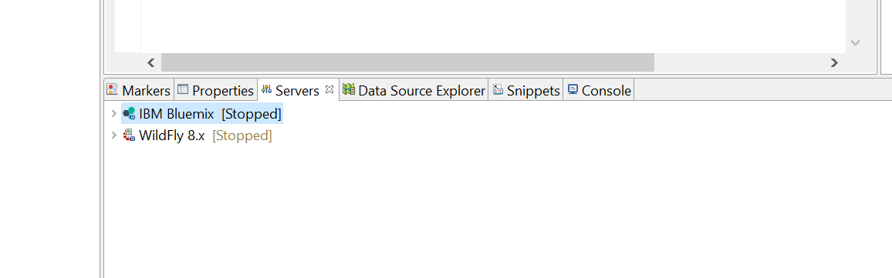
6.2:Working with Bluemix IBM Bluemix
Working with Bluemix with Eclipse
Download the code from Git Repository
Open Eclipse → Go to help →go to marketplace→install bluemix
Create a server IBM bluemix
Check on server tab in eclipse

Slide 16
6.2:Working with Bluemix IBM Bluemix
Working with Bluemix with Eclipse
Now either import the project download from github repository or create new dynamic project→Creating here DemoWebBlueMix
Work on code
Now Run on IBM bluemix server
Write buildpack & it will create manifest.yml
mainfest,.yml
applications:
- name: DemoWebBlueMix
memory: 512M
host: DemoWebBlueMix
domain: mybluemix.net

Slide 17
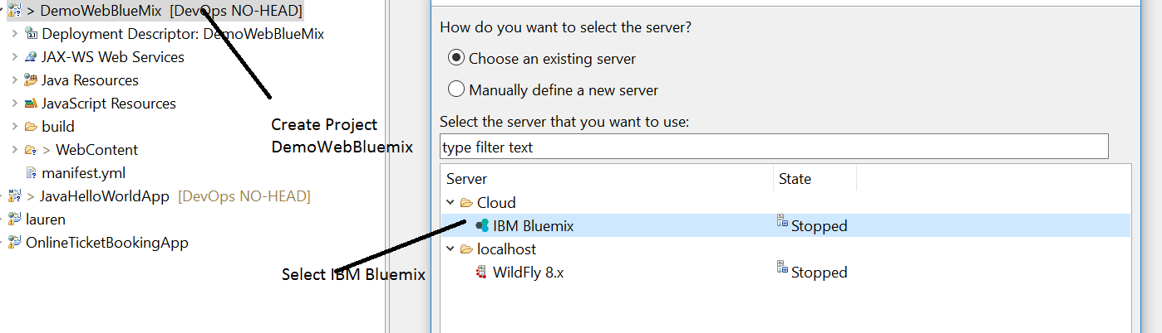
6.2:Working with Bluemix IBM Bluemix
Working with Bluemix with Eclipse
Write Bluemix email id & password
Directly Upload on https://console.ng.bluemix.net/dashboard/apps

Slide 18
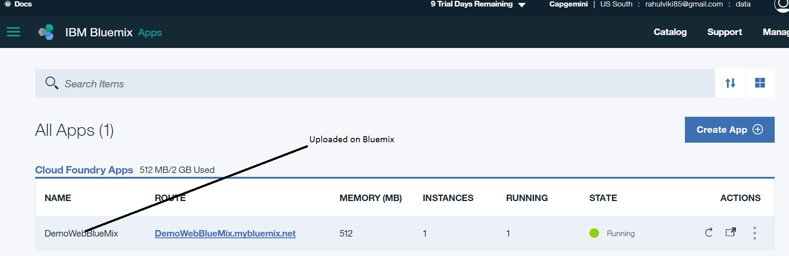
6.2:Working with Bluemix IBM Bluemix
Working with Bluemix with Eclipse
Our project deployed on bluemix dashboard→ https://console.ng.bluemix.net/dashboard/apps

Slide 19
6.3:Bluemix with DevOps IBM Bluemix
DevOps with Bluemix
Continuous Delivery is a practice by which we can build and deploy our software so that it can be released into production at any time.
With Delivery Pipeline, which is included in IBM Bluemix Continuous Delivery, we can achieve continuous delivery in a consistent and reliable way by dividing the software delivery process into stages.
The goal is for code to progress through each stage automatically with minimal human intervention.
Build jobs compile and package our app source code from Git repositories. The build jobs produce deployable artifacts, such as WAR files or Docker containers for IBM Containers.
A toolchain is a set of tool integrations that support development, deployment, and operations tasks. The collective power of a toolchain is greater than the sum of its individual tool integrations.
Open toolchains are available in the Public and Dedicated environments on IBM Bluemix.

Slide 20
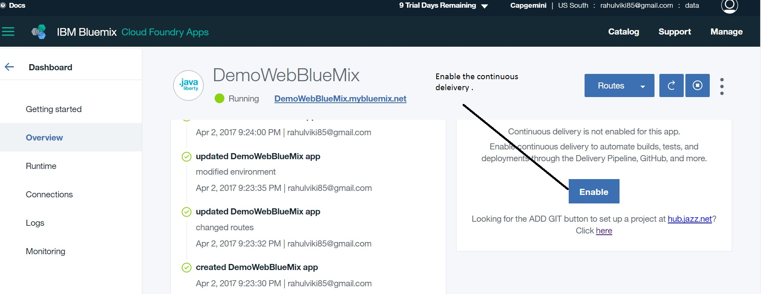
6.3:Bluemix with DevOps IBM Bluemix
Steps to enable toolchain for DevOps
Click on project which is deployed on bluemix and we will get this page below

Slide 21
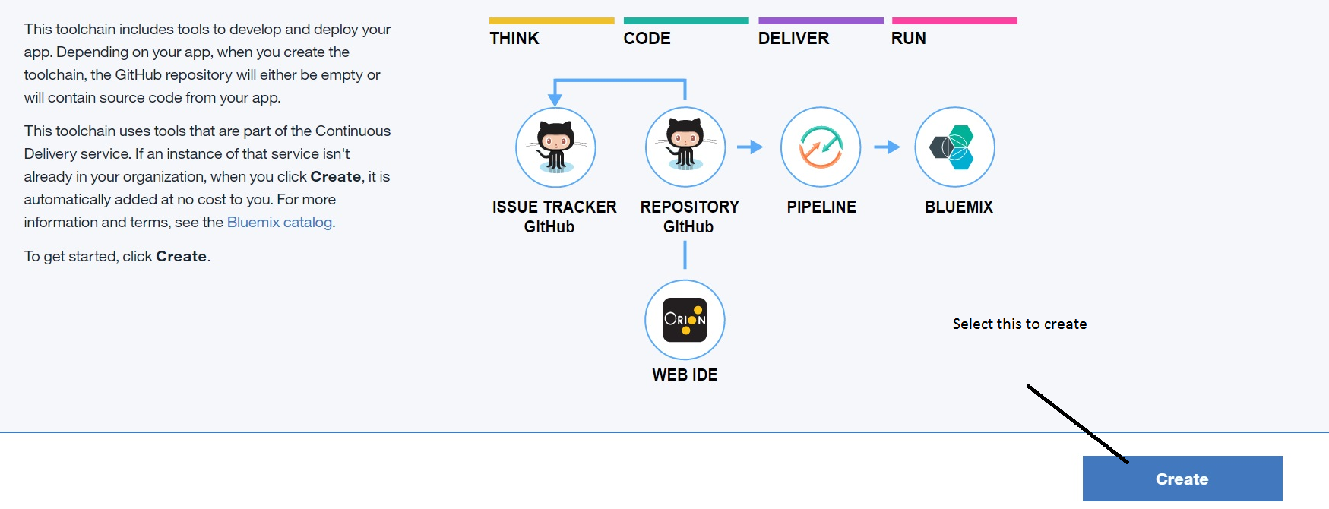
6.3:Bluemix with DevOps IBM Bluemix
On the Simple Cloud Foundry toolchain creation page, review the diagram of the toolchain that you are about to create. The diagram shows each tool integration in its lifecycle phase in the toolchain.

Slide 22
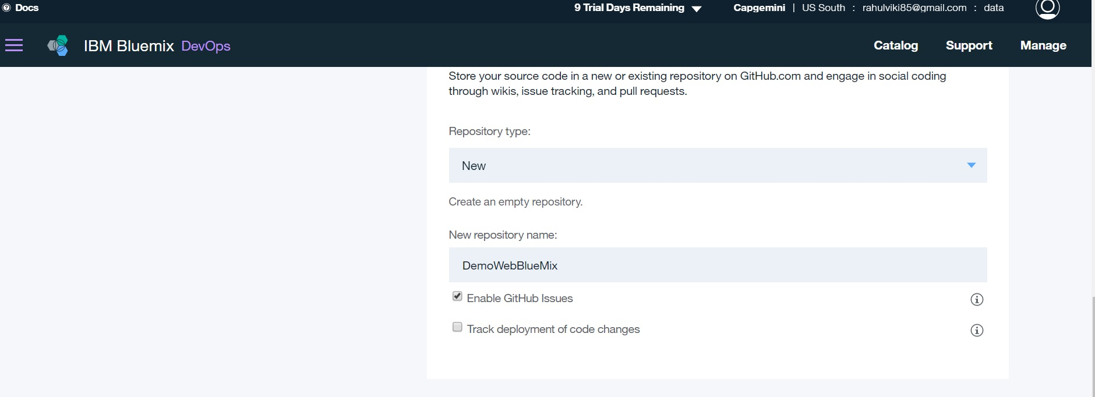
6.3:Bluemix with DevOps IBM Bluemix
If we haven't authorized with GitHub, we are prompted to do so. Click Authorize and follow the instructions to link your Bluemix account to a GitHub account.

Slide 23
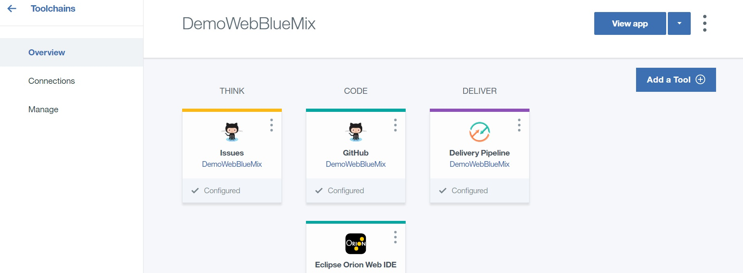
6.3:Bluemix with DevOps IBM Bluemix
Click Create. Several steps run automatically to set up your toolchain:
The toolchain is created.
The delivery pipeline is created and triggered.
The DemoWebBlueMix is cloned into your GitHub account.
The toolchain is associated with your app. When we push changes to the toolchain's GitHub repo, the pipeline automatically builds and deploys the app.

Slide 24
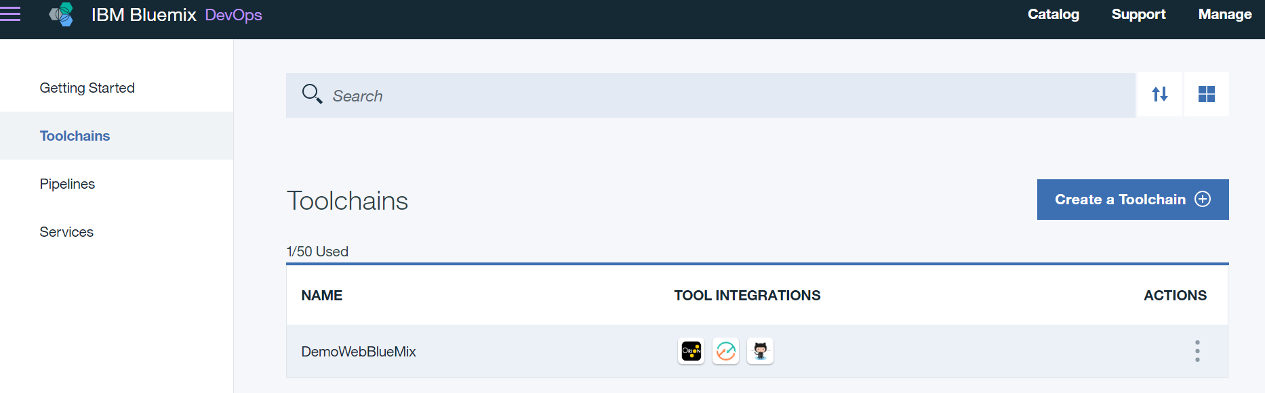
6.3:Bluemix with DevOps IBM Bluemix
Return to the toolchain page , the Toolchains page displays all the toolchains that are in our org.

Slide 25
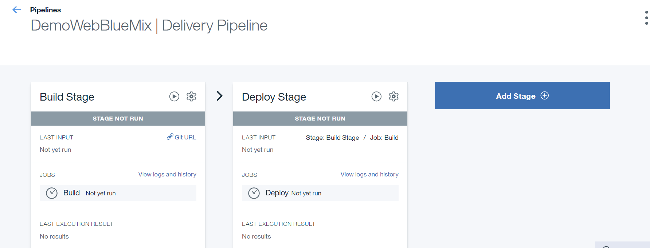
6.3:Bluemix with DevOps IBM Bluemix
If we click on build stage & deploy stage ,we can add maven ,ant,npm(node) etc and we can configure to deploy on which environment.

Slide 26

6.3:Bluemix with DevOps IBM Bluemix
Checking the application on bluemix

Slide 27

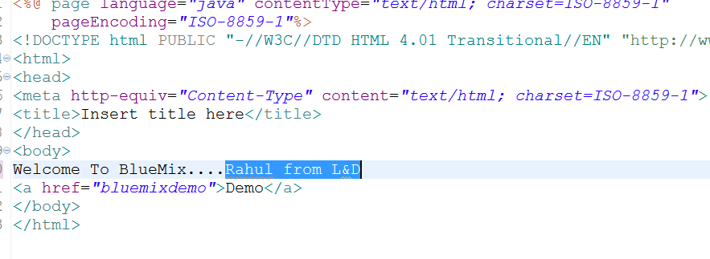
6.3:Bluemix with DevOps IBM Bluemix
Now again change in the code & push to github repository & see the change ,its build automatically

Slide 28
6.4:other tools of devops IBM Bluemix
Puppet
Puppet Enterprise makes it easy to automate the provisioning, configuration and ongoing management of our machines and the software running on them.
Changes and automatically enforce the consistency of systems and devices - across physical and virtual machines, on premise or in the cloud.
Reduce cycle times to get more software deployed
Make fast, iterative changes
Define a configuration once, and apply it to thousands of machines
Automatically remediate configuration drift
Get detailed insight into hardware and software configurations

Slide 29
6.4:Other tools of devops IBM Bluemix
Chef
Chef is a powerful automation platform that transforms infrastructure into code. Whether we are operating in the cloud, on-premises, or in a hybrid environment
Chef automates how infrastructure is configured, deployed, and managed across our network, no matter its size.
Once we done developing and testing our code locally, on our workstation, we can upload it to the Chef server.
We need to install a text editor to write code and Chef DK to get the tools to test our code. The primary testing tools we use are Foodcritic, Test Kitchen and ChefSpec.
Notes:
Chef is a powerful automation platform that transforms infrastructure into code. Whether you’re operating in the cloud, on-premises, or in a hybrid environment, Chef automates how infrastructure is configured, deployed, and managed across your network, no matter its size.
You create and test your code on your workstation before you deploy it to other environments. Your workstation is the computer where you author your cookbooks and administer your network. It’s typically the machine you use everyday. It can be any OS you choose, whether it’s Linux, Mac OS, or Windows.
You’ll need to install a text editor (whatever you like) to write code and Chef DK to get the tools to test your code. The primary testing tools you’ll use are Foodcritic, Test Kitchen and ChefSpec. With them, you can make sure your Chef code does what you intended before you deploy it to environments used by others, such as staging or production.
When you write your code, you use resources to describe your network. A resource corresponds to some piece of infrastructure, such as a file, a template, or a package. Each resource declares what state a part of the system should be in, but not how to get there. Chef handles these complexities for you. Chef provides many resources that are ready for you to use. You can also write your own resources if you need to.
A Chef recipe is a file that groups related resources, such as everything needed to configure a web server, database server, or a load balancer. A Chef cookbook provides structure to your recipes and, in general, helps you stay organized.
The Chef DK includes other useful tools such as InSpec, which is an open-source testing framework with a language for specifying compliance, security and policy requirements. Command-line tools include chef-solo, which runs locally and mimics an actual Chef server, knife for interacting with the Chef server, and chef for interacting with your local chef-repo.

Slide 30
Demo
Basic Demo on Bluemix
Bluemix with DevOps
Notes:
Add the notes here.
Add instructor notes here.

Slide 31
Lab
Bluemix with CLI & eclipse
Creating Toolchain
Notes:
Add the notes here.
Add instructor notes here.

Slide 32
Summary
IBM Bluemix is IBM's innovative cloud computing platform that combines platform as a service (PaaS) with infrastructure as a service (IaaS).
We can deploy application using CLI & Eclipse
Other tools of devops
Notes:
Add the notes here.
Add instructor notes here.

Slide 33
Review Question
A developer logs in to IBM Bluemix with the cf login command and then issue the cf marketplace command, what will be the result?
The command output will list all the services on IBM Bluemix which are not free to use
The command output will list all the services and plans offered in IBM Bluemix for a logged in user
The command output will show required attributes for an application to be made available on IBM cloud market place
The command will create an application on IBM blue mix called market place based on contents in the current directory where the cf command is issues
Notes:
Add the notes here.
Q1. The command output will list all the services and plans offered in IBM Bluemix for a logged in user
Q2. Application name
Q3. By changing the region in the IBM Bluemix web console and redeploying the application and services

Slide 34
Review Question
In IBM BluemixPaaS a developer wants to customize application deployment properties, which field is mandatory for manifest.yml?
Host
Disk Quota
Application name
Environment Name
In IBM BluemixPaaS how can developers redeploy an application from one Bluemix region to another region
By changing the route of the application
By changing the environment variables in VCAP service
By updating the user profile and redeploying the application and services
By changing the region in the IBM Bluemix web console and redeploying the application and services
Notes:
Add the notes here.
Add instructor notes here.

